Slide 1
Exceptions

Slide 2
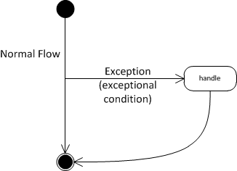
Exceptions?
"badly formed code
will not be run."
In java Exceptions are the way of handling errors at runtime

Slide 3

Exceptional Condition
An exceptional condition is a problem that prevents the continuation of the current method or scope (block of code)
Usually it means that you don’t have the information necessary to deal with the problem in the current context

Slide 4
Exceptional Condition: Example
int x = 5, y = 0;
int z = x/y; //throws an ArithmeticException
Zero denominator is an unexpected value, JVM can’t deal with it.

Slide 5
What happens
int x = 5, y = 0;
int z = x/y; //throws an ArithmeticException
The exception object is created
The current path of execution is stopped
The exception-handling mechanism takes over and begins to look for an appropriate place to continue executing the program

Slide 6
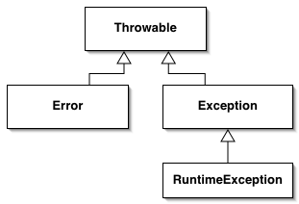
Exception Object
Exception is an Object. So it has a class.
public class ArithmeticException extends RuntimeException {
private static final long serialVersionUID = 2256477558314496007L;
/**
* Constructs an {@code ArithmeticException} with no detail
* message.
*/
public ArithmeticException() {
super();
}
/**
* Constructs an {@code ArithmeticException} with the specified
* detail message.
*
* @param s the detail message.
*/
public ArithmeticException(String s) {
super(s);
}
}

Slide 7
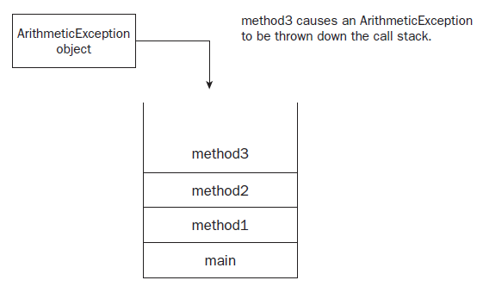
Exception Propagation
Once occurred Exception stops the current method (code block) execution and is propagated through all the methods in call stack
until exception handler is found
Looking for handlers
JVM handles

Slide 8
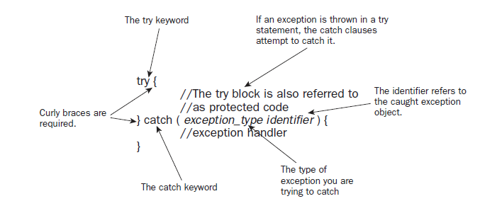
Exception handling
Exceptions are handled within try – catch –finally blocks

Slide 9
Example
int x = 5, y = 0, z = 0;
try {
z = x/y; //throws an ArithmeticException
} catch (ArithmeticException e) {
// code to handle exception
z = 0;
}

Slide 10
Multiple catch Clauses
try {
someMethod(); // may throw Ex1 or Ex2
} catch (Exception1 e) {
// handle Exception1
} catch (Exception2 e) {
// handle Exception2
}
or (since java 7):
} catch (Exception1 || Exception2 ex) {
// handle Exception1 or Exception2
}

Slide 11
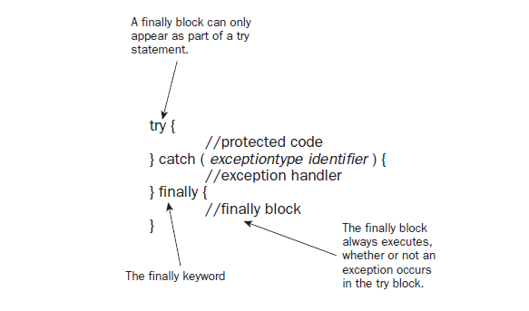
finally

Slide 12
finally
try {
callMethod();
} finally {
// always to some job here;
}

Slide 13
?

Slide 14
Closing resource
FileOutputStream out = new FileOutputStream("output.txt");
out.write(…);
out.close();
Throws IOException
As result stream will never be closed

Slide 15
Close resources in finally
FileOutputStream out = new FileOutputStream("output.txt");
try {
out.write(…);
} finally {
if (out != null) {
out.close();
}
}

Slide 16
try-with-resources statement
Since java7
try ( FileOutputStream out = new FileOutputStream("output.txt") )
{
out.write(…);
}
This guarantees that close method of the out will always be called
!Note: FileOutputStream should implement AutoCloseable

Slide 17
public class AutoClose implements AutoCloseable {
@Override
public void close() {
System.out.println(">>> close()");
throw new RuntimeException("Exception in close()");
}
public void work() throws MyException {
System.out.println(">>> work()");
throw new MyException("Exception in work()");
}
public static void main(String[] args) {
try (AutoClose autoClose = new AutoClose()) {
autoClose.work();
} catch (MyException e) {
e.printStackTrace();
}
}
}
>>> work()
>>> close()
MyException: Exception in work() at AutoClose.work(AutoClose.java:11)
at AutoClose.main(AutoClose.java:16)
Suppressed: java.lang.RuntimeException: Exception in close()
at AutoClose.close(AutoClose.java:6)
at AutoClose.main(AutoClose.java:17)

Slide 18
?

Slide 19
Exception Class
Exception class has properties and methods
Base class for all exceptions is the Throwable
Java provides a lot of different classes that describes different types of exceptions.
All exceptions belong to one of three types: checked, runtime exceptions and error
Errors and runtime exceptions are unchecked exceptions

Slide 20
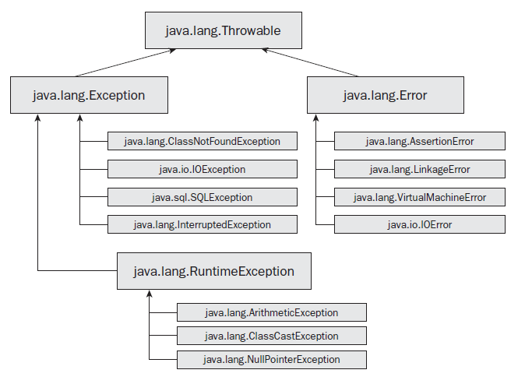

Slide 21
java.lang.Throwable
The parent class of all objects that can be thrown (either by the JVM or by using the throw keyword).
Only objects of type Throwable or subclasses of Throwable can appear in a catch clause
Throwable provides information about the stack trace

Slide 22
java.lang.Error
Used to indicate problems that mostly cannot be fixed at runtime
Usually is not handled

Slide 23
java.lang.Exception
Base class for both checked and Runtime (unchecked) exceptions.
Checked exception – exception which well-written application should anticipate and recover from
If you call method that throws checked exception you must surround it with try-catch block

Slide 24
java.lang.RuntimeException
Any error raised due to the application logic or miscalculation
Application usually cannot anticipate or recover from
Usually indicate programming bugs, such as logic errors or improper use of an API
Usually are not subject to handle

Slide 26
?

Slide 27
Custom Exception
To declare your custom exception you need to create new class and extend it from on of base exception classes (depends on what type of exception do you need).
public class MyCustomException
extends RuntimeException {
public MyCustomException(String message) {
super(message);
}
}

Slide 28
Throwing Exception
The throw Keyword
if (t == null) {
throw new NullPointerException("t = null");
}
Or re-throwing exception:
…
} catch (IOException ex) {
// do something
throw ex;
}

Slide 29
The throws Keyword
A method uses the throws keyword to declare that it might throw an exception. For example, the following method named readFromFile declares that it might throw a java.io.IOException:
public void readFromFile(String fileName) throws IOException {
FileReader fis = new FileReader(fileName);
System.out.println(fileName + “ was found”);
char data = (char) fis.read();
System.out.println(“Just read: “ + data);
System.out.println(“End of readFromFile”);
}
Because IOException is a checked exception, any method that invokes readFromFile must either handle or declare the IOException.
Exception may be thrown here

Slide 30
Why Not Catch Errors or Runtime Exceptions?
catching an error is often pointless because recovering from an error is difficult and often impossible.
catching runtime exception is usually considered as poor programming design preferred technique for runtime exceptions is to let them crash your program, because, in general, runtime exceptions can be avoided with better code

Slide 31
Stack trace
stack trace - shows the sequence of method calls that brought you to the point at which the exception was thrown
Throwable:
printStackTrace(…)
getStackTrace( )
Exception in thread “main” java.lang.StackOverflowError
at sun.nio.cs.SingleByteEncoder.encodeArrayLoop(SingleByteEncoder.
java:91)
at sun.nio.cs.SingleByteEncoder.encodeLoop(SingleByteEncoder.java:130)
at java.nio.charset.CharsetEncoder.encode(CharsetEncoder.java:544)
at sun.nio.cs.StreamEncoder.implWrite(StreamEncoder.java:252)
at sun.nio.cs.StreamEncoder.write(StreamEncoder.java:106)
at java.io.OutputStreamWriter.write(OutputStreamWriter.java:190)
at java.io.BufferedWriter.flushBuffer(BufferedWriter.java:111)
at java.io.PrintStream.newLine(PrintStream.java:495)
at java.io.PrintStream.println(PrintStream.java:687)
at StackOverflowDemo.go(StackOverflowDemo.java:5)
at StackOverflowDemo.go(StackOverflowDemo.java:6)
at StackOverflowDemo.go(StackOverflowDemo.java:6)

Slide 32
Exception chaining
public class MyException extends Exception {
public MyException(Exception cause, String message) {
super(message, cause);
}
}
****
} catch (IOException ex) {
throw new MyException(ex, “cannot read file ” + filename);
}

Slide 33
?

Slide 34
Summary
Exceptions:
Are java objects
They are used to reduce the complexity of error-handling code
Represent many types of problems that may occur during program execution
Can be handled in different ways
May stop program flow if not handled

